Slide 1

Video #7
HARDWARE - 6
BEGINNER TO EXPERT GUARANTEED
ULTIMATE IT COURSE
ACCESS NETWORKING COURSE PLAYLIST LINK IN DESCRIPTION
SUBSCRIBE!!!

Slide 2
ANSWERS
1. Name any 5 Brands of HDD Manufacturers ? (Seagate/WD/G-Tech/Kingston/Toshiba)
2. (CD-R - Compact Disc Recordable, RW – Rewritable & ROM – Read only Memory)
3. Cache Memory is Volatile Memory (Volatile/Non-Volatile)
4. BIOS memory is a type of ROM Memory ? (ROM/RAM/Firmware)
5. Frequency of RAM is measure in Megahertz (Mhz) ?
Solve all question and comment down answers...

Slide 3
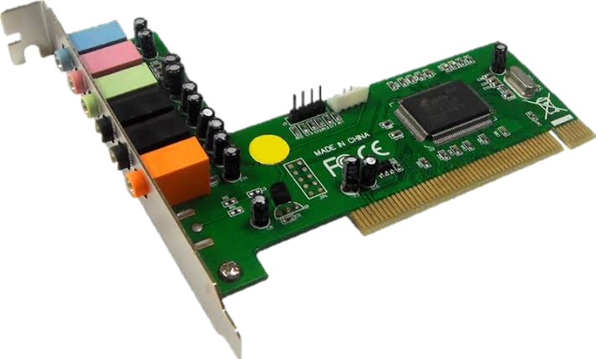
AUDIO or SOUND Card
A sound card is an expansion card or IC for producing sound on a computer that can be heard through speakers or headphones. Although the computer does not need a sound device to function, they are included on every machine in one form or another, either in an expansion slot or built into the motherboard

Slide 4
Features:
The NIC Card also known as Hardware Card or Network Card of your system
It contains your 12 digit alphanumeric MAC Address which uniquely identify your system
It contains Ethernet Port to connect Ethernet Cable with RJ-45 Port to be a part of Network
Network Card can also with 2 different segments Wired or Wireless adapters

Slide 5
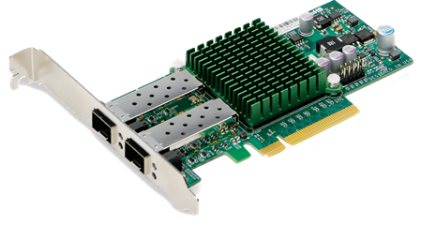
NIC Card
A network interface card (NIC) is a hardware component without which a computer cannot be connected over a network. It is a circuit board installed in a computer that provides a dedicated network connection to the computer. It is also called network interface controller, network adapter or LAN adapter.

Slide 6
Features:
The NIC Card also known as Hardware Card or Network Card of your system.
It contains your 12 digit alphanumeric MAC Address which uniquely identify system.
Network Card contains Ethernet Port to connect Ethernet Cable with RJ-45 Port to be a part of Network.
Network Card can also with 2 different segments Wired or Wireless adapters

Slide 7
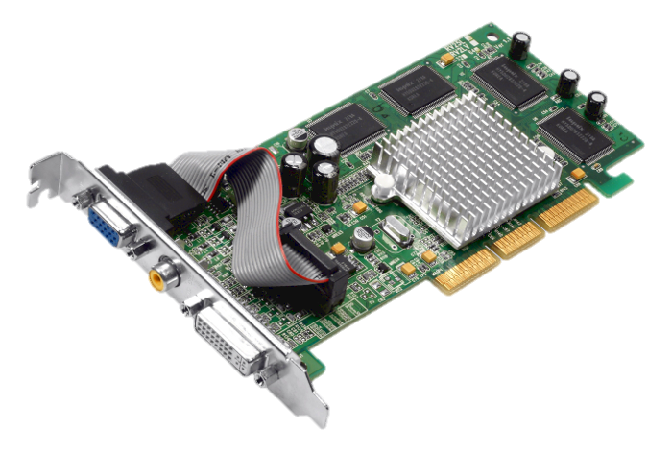
What is VIDEO CARD?
A video card (also called a video adapter, display card, graphics card, graphics board, display adapter or graphics adapter and sometimes preceded by the word discrete or dedicated to emphasize the distinction between this implementation and integrated graphics) is an expansion card which generates a feed of output images to a display (such as a computer monitor).

Slide 8
What is the function of the Video Card?
The function of a VGA card
(video card) is to provide an interface between the hardware and the software. Basically this means that it plugs in to the monitor and shows what the computer is doing.

Slide 9
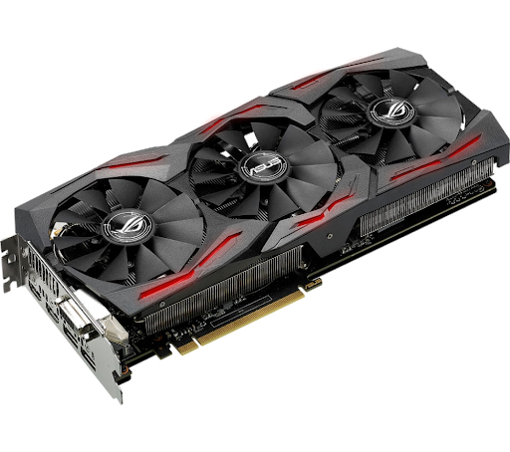
GRAPHIC CARD
Graphics card or video card is display adaptor or hardware component whose function is to generate output images to display. It is also called as dedicated expansion card. It is of 2 types :
1. Internal
2. External

Slide 10
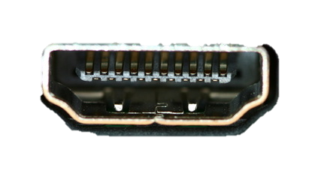
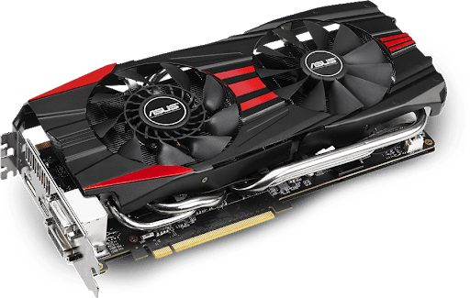
Outputs:
1. DVI
2. VGA
3. HDMI

Slide 11








Slide 12


Wi-Fi
◆ What is Wi-Fi
◆ Short for “Wireless Fidelity”
◆ A trademark of the Wi-Fi Alliance
◆ The brand name for products using the IEEE 802.11 family of standards
◆ Commonly used for “wireless local area network” (WLAN)

Slide 13

Bluetooth
◆ Wireless Personal Area Networks (WPAN)
◆ Design goal
◆ Cable replacement
◆ Low cost
◆ Low power
◆ Small size
◆ For mobile devices
◆ Standard: IEEE 802.15.1

Slide 14
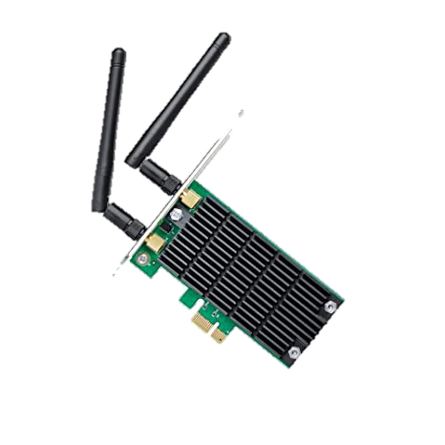
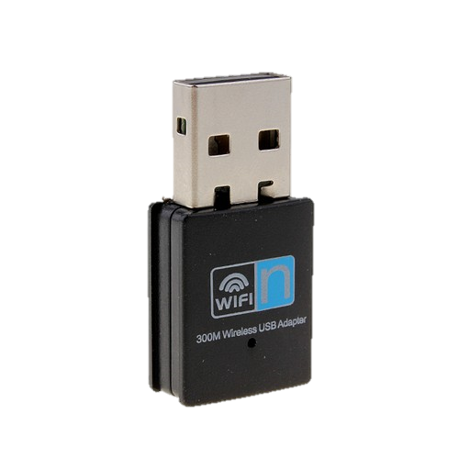
Wi-Fi CARD
Internal
External
Internal
External

Slide 15
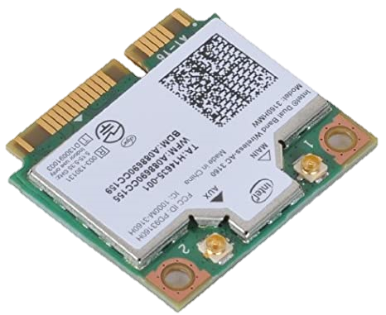
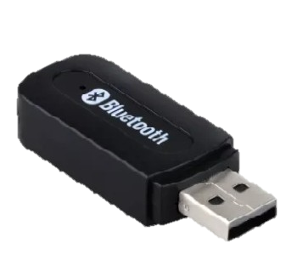
Bluetooth CARD
Internal
External
Internal
External

Slide 16
Questions:-
1. NIC Card Use ?
2. 5 Manufacturers of Graphic Cards ?
3. PCIe Full Form ?
4. Which has MAC Address ? (WiFi/Bluetooth/NIC/Graphic card)
5. Which Expansion card has HDMI port ? (NIC Card/Audio Card/Graphic Card)
Solve all question and comment down answers...

